Slide 1

Cụm tính từ
https://langmaster.edu.vn/tong-hop-100-cap-tu-doi-lap-thong-dung-nhat-a70i1493.html

Slide 2


Bãi chức ai
1
to remove someone from their job, especially because they have done something wrong:
Dismiss sb
/dɪˈsmɪs/
Ex: He has been dismissed from his job for incompetence.
kém năng lực.
/ɪnˈkɑːm.pə.t̬əns/

Slide 3
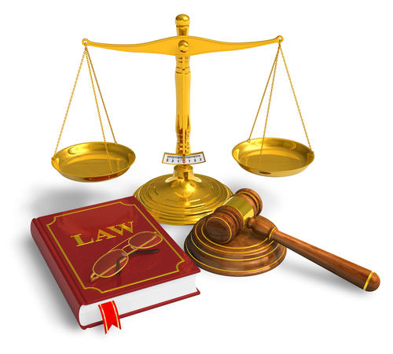
Có trách nhiệm về pháp lí
2
having (legal) responsibility for something or someone:
Liable for
/ˈlaɪ.ə.bəl/
adj
The law holds parents liable if a child does not attend school.
The sellers were liable for all the damage

Slide 4
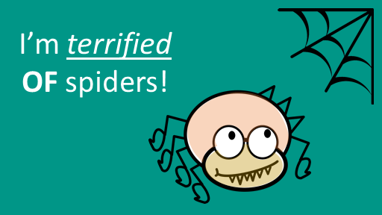

khiếp sợ, rất kinh hãi
3
Terrified of
adj
/ˈter.ə.faɪd/
I'm terrified of the dark.

Slide 5

Biết ơn về việc gì đó
4
Grateful for sth
adj
/ˈɡreɪtfl/
Thank you for doing this. I really am so grateful.
She said she was grateful for the support shown by the community.

Slide 6


